Slide 1
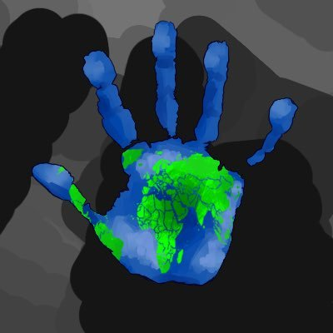
“The Five Themes of Geography”
Jeannine Kuropatkin
Teacher Consultant
Arizona Geographic Alliance
jkuropatkin@gmail.com

Slide 2
Purpose of the “Five Themes”
For Teachers
Organizing framework for teaching geography in the K-12 classroom
For Students
Valuable tool for developing
a “geographic perspective”

Slide 3
What are the
“Five Themes of Geography?”
Location
Place
Human-Environment Interaction
Movement
Regions

Slide 4
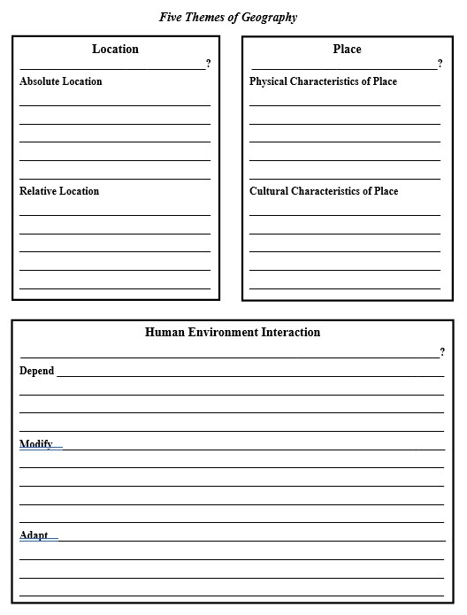
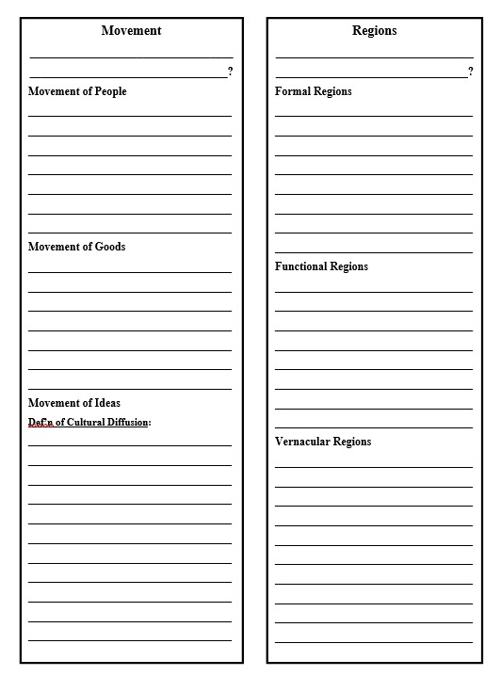
“5 Themes” Reference Sheet
(for Note-taking)

Slide 5
Location
Where is it?
Absolute Location
Relative Location
Notes:
Instruct students to write the QUESTION in the “5 Themes” Graphic Organizer

Slide 6
Absolute Location
To pinpoint an exact position on Earth
Uses a grid system
Street Address
Alpha-numeric
Latitude & longitude
Notes:
Instruct students to write these notes in the “5 Themes” Graphic Organizer

Slide 7

Absolute Location
What is the global address of Phoenix?
33.5° N and 112° W
What is the global address of Tucson?
32° N and 111° W
What is the global address of Page?
37° N and 111.5° W

Slide 8
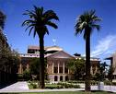
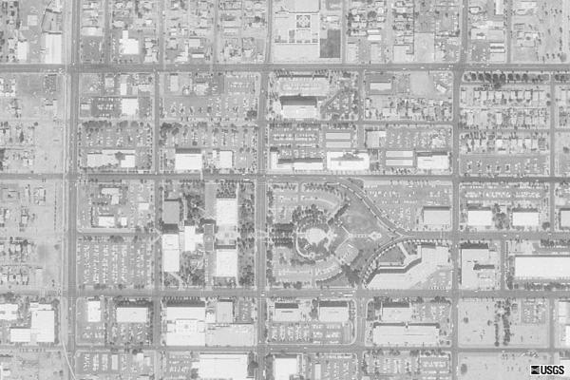
Absolute Location
1700 West Washington
Phoenix, Arizona 85007
The Arizona state
capitol building is
located at:

Slide 9
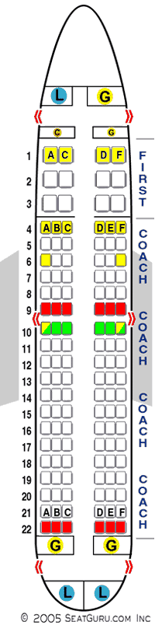
Absolute Location
Your assigned seat
on the airplane is
14-C.

Slide 10
Relative Location
Gives a general sense of position on Earth
in relation to another position.
Uses descriptive phrases
  Phoenix is located in
  south-central Arizona,
  100 miles NORTH of Tucson.
Notes:
Instruct students to write these notes in the “5 Themes” Graphic Organizer

Slide 11
Relative Location
Describe the relative
location of Flagstaff.
Flagstaff is located in
northern Arizona,
125 miles NE of Phoenix.
Describe the relative
location of Yuma.
Yuma is located in the
SW corner of Arizona,
220 miles NW of Tucson.

Slide 12
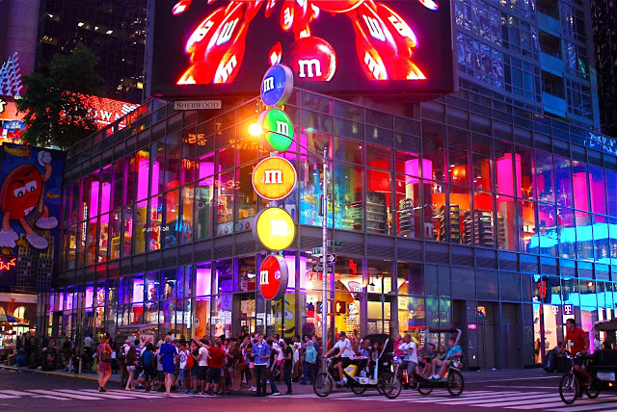
Relative Location is frequently used in everyday situations.
“I live two blocks from the school”
“The gas station is across the street from Taco Bell”
“Meet you in front of the M&M’s World Store in Times Square!”
Times Square, New York City

Slide 13
Place
What is it like there?
The special character of a location
that makes it unique.
Physical Characteristics
Human Characteristics
Notes:
Instruct students to write the QUESTION in the “5 Themes” Graphic Organizer

Slide 14
Physical Characteristics of Place
Unique natural features;
Due to “mother nature”
Climate Landforms
Bodies of Water
Elevation Vegetation
Wildlife
Notes:
Instruct students to write these notes in the “5 Themes” Graphic Organizer

Slide 15
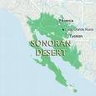
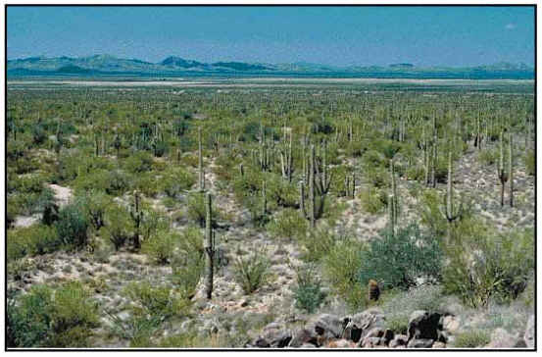
Physical Characteristics of Place
The saguaro cactus, palo verde tree, and prickly
pear cactus grow wild in the Sonoran Desert.

Slide 16
Human Characteristics of Place
Unique cultural features;
Due to human beings
Language Food
Cultural Landmarks
Religions Clothing Traditions
Notes:
Instruct students to write these notes in the “5 Themes” Graphic Organizer

Slide 17
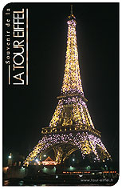
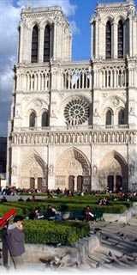
Human Characteristics of Place
The Eiffel Tower and the
Cathedral of Notre Dame
are two popular tourist
spots in Paris, France.

Slide 18
Human-Environment
Interaction
What is the relationship between humans and their environment?
Humans depend on their environment.
Humans modify their environment.
Humans adapt to their environment.
Notes:
Instruct students to write the QUESTION in the “5 Themes” Graphic Organizer

Slide 19
HEI
Humans depend on their environment.
Survival Needs:
Water Oxygen
Food
Shelter Warmth
Notes:
Instruct students to write these notes in the “5 Themes” Graphic Organizer

Slide 20
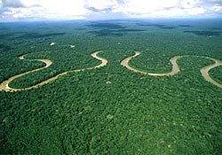
HEI
Humans depend on their environment.
One-fifth of the world’s oxygen supply
comes from the tropical rain forests.

Slide 21
HEI
Humans modify their environment.
The environment can modify humans.
Modify means “to change”
Change can be positive or negative!
Pollution Deforestation
Irrigation Mining Agriculture
Cities Ozone Hole Global Warming
Natural Disasters Drought Hurricanes
Notes:
Instruct students to write these notes in the “5 Themes” Graphic Organizer

Slide 22
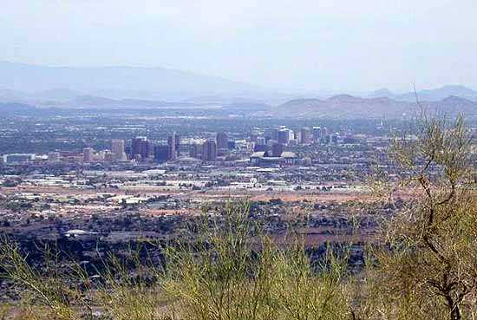
HEI
Humans modify their environment.
Urban Sprawl
Phoenix has experienced phenomenal
growth in the past decade.

Slide 23
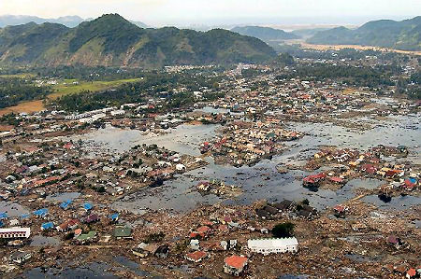
HEI
The environment can modify humans.
2004 Tsunami Tragedy
Most Indian Ocean countries suffered horrendous death
tolls due to a lack of an adequate warning system.

Slide 24
HEI
Humans adapt to their environment.
All the ways humans protect
themselves from the environment.
Protective clothing Protective shelter
Use of natural resources
Medicines Emergency Evacuation Plans
Notes:
Instruct students to write these notes in the “5 Themes” Graphic Organizer

Slide 25
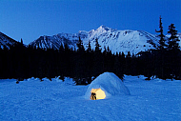
HEI
Humans adapt to their environment.
The Inuit of the Arctic
The Inuits wear clothing made out of animal pelts and fur. They live in ice block igloos to protect themselves from temperatures as low as -76°F.

Slide 26
Movement
What is the connection between people and places?
Movement of People
Movement of Goods
Movement of Ideas
Notes:
Instruct students to write the QUESTION in the “5 Themes” Graphic Organizer

Slide 27
Movement of People
What is the connection between people and places?
Migration Immigration
Refugees Vacations
Job Relocations Transportation
Commuters Urbanization
Notes:
Instruct students to write these notes in the “5 Themes” Graphic Organizer

Slide 28
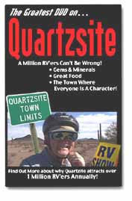
Movement of People
Migration
“Snowbirds in Arizona”
“Snowbirds,” aka senior citizens from the cold Midwest, migrate to Arizona every winter.

Slide 29
Movement of Goods
What is the connection between people and places?
Trade: Imports & Exports
Smuggling Drug Cartels
International Shipping Routes
Interstate Trucking Routes
Global Supply Chains
Notes:
Instruct students to write these notes in the “5 Themes” Graphic Organizer

Slide 30

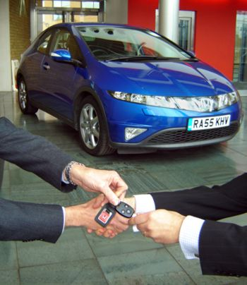
Movement of Goods
Trade
The US imports Honda cars, motorcycles, and trucks from Japan.

Slide 31
Movement of Ideas
What is the connection between people and places?
Fads Books Magazines
Newspapers Television Radio
Internet & Hi Tech Communications
Cultural Diffusion
Borrowing of foods, customs, holidays, religions, languages, etc. from one culture to another
Notes:
Instruct students to write these notes in the “5 Themes” Graphic Organizer

Slide 32



Movement of Ideas
Fads: Japanese Manga & Anime
From Pokemon Go to Yugioh and Naruto, Japanese anime has been sweeping the U.S. for several decades.

Slide 33
Regions
How can an area be defined by
similar or unifying characteristics?
Political Regions
Physical Regions
Cultural Regions
Notes:
Instruct students to write the QUESTION in the “5 Themes” Graphic Organizer

Slide 34
Political Regions
Areas that share
similar government or similar treaty alliances.
Cities Counties States
Provinces Countries Territories
Trade Alliances Free Trade Zones
Notes:
Instruct students to write these notes in the “5 Themes” Graphic Organizer

Slide 35
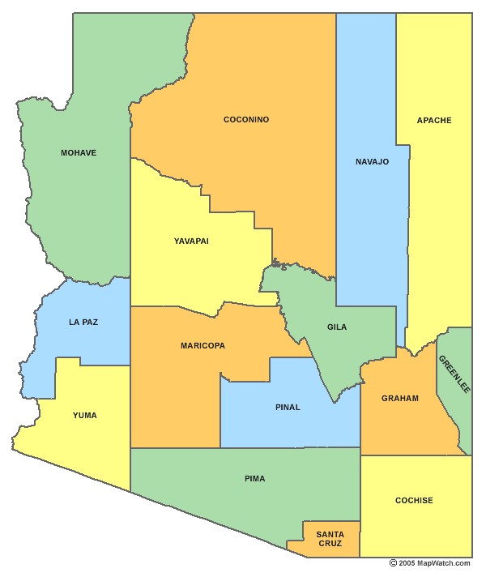
Political Regions
Counties
The cities of Mesa,
Tempe, Scottsdale,
and Phoenix are in
the political region
called Maricopa
County since they share
the same county
government.

Slide 36
Physical Regions
Areas that share
similar physical (mother nature) features.
Bodies of Water: rivers, lakes, oceans
Climate Ecosystems Wildlife
Landforms: mountains, deserts, plains, plateaus
Notes:
Instruct students to write these notes in the “5 Themes” Graphic Organizer

Slide 37
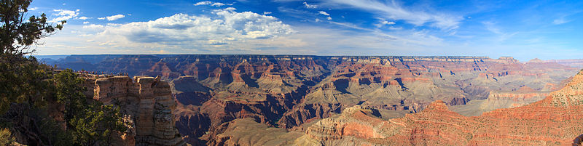
Physical Regions
Landforms
Arizona’s Grand Canyon is part of the greater Colorado Plateau region, a physical region characterized by elevations ranging from 5,000-8,000 feet above sea level.

Slide 38
Cultural Regions
Areas that share
similar cultural (human) characteristics.
Languages Religions History
Ancestry Customs Traditions
Land Use Occupations
Notes:
Instruct students to write these notes in the “5 Themes” Graphic Organizer

Slide 39
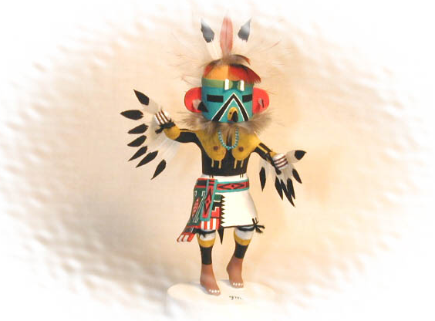
Cultural Regions
Hopi Reservation
Common History,
``Ancestry and Traditions
Hopis have retained their own distinctive tribal practices, such as the sacred kachina dance ceremonies, and their native Hopi language.

Slide 40
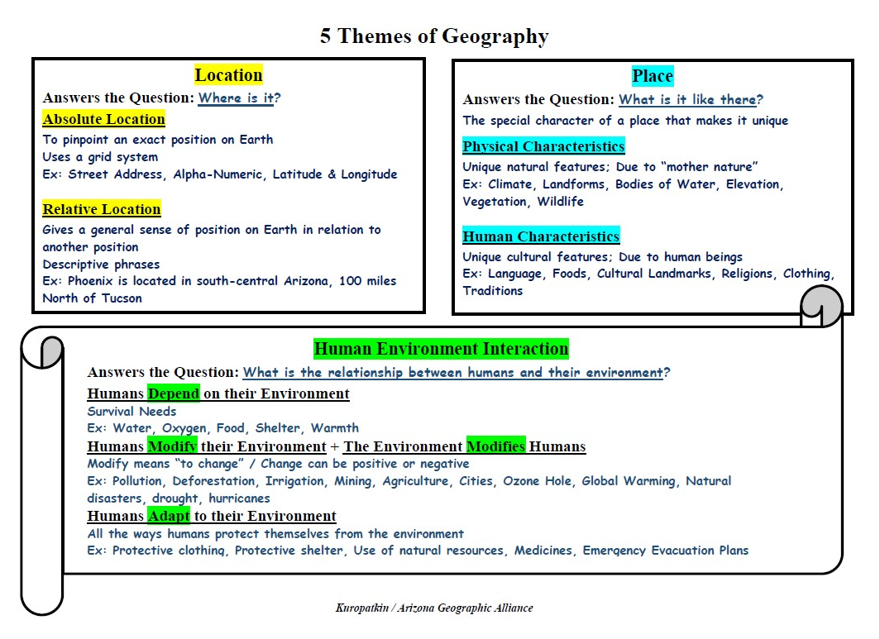
“5 Themes” Reference Sheet

Slide 41
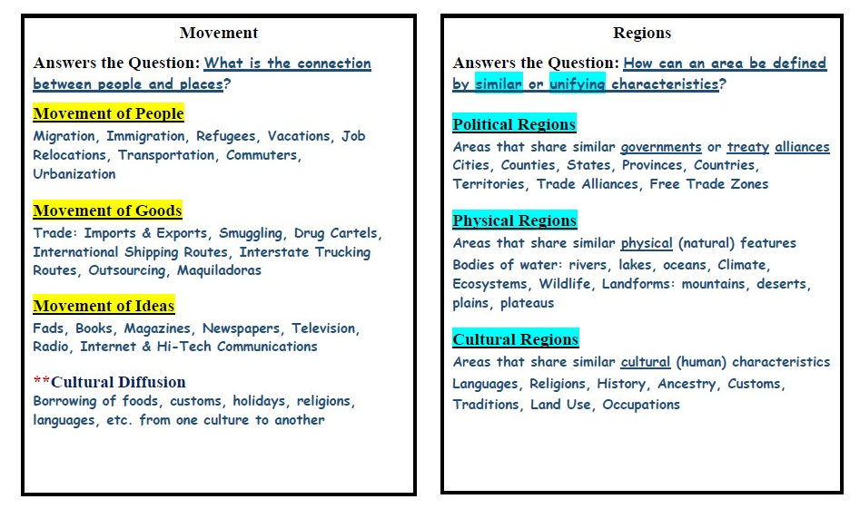
“5 Themes” Reference Sheet

Slide 42
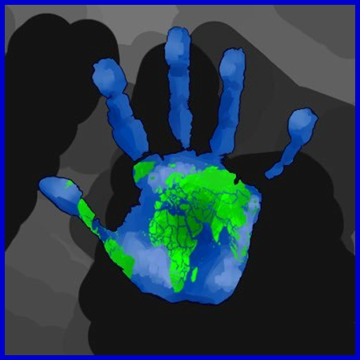
“The Five Themes of Geography”
END of SLIDESHOW

